Slide 1
OPEN EDUCATION RESOURCES
Include Me Innovative Training Course
MODULE 1: Introduction to Community Mediation
This programme has been funded with support from the European Commission. The author is solely responsible for this publication (communication) and the Commission accepts no responsibility for any use that may be made of the information contained therein 2020-1- FI01-KA203-066490

Slide 2
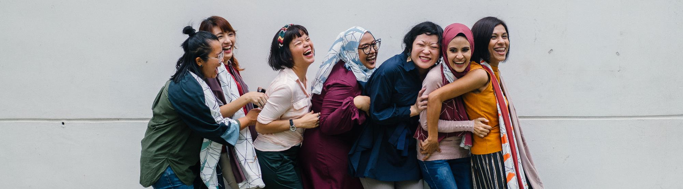
Welcome to the
Open Education Resources
A unique approach to deliver mediation skills training to adult learners in creative, dynamic ways, allowing them to maximise inclusion through mediation.

Slide 3
Overview, how you will benefit
1
Defining community mediation for inclusion
In Module 1, you will find out what the concept of mediation means in the peer-to-peer, migrant to a migrant setting. We will define the basic principles behind community mediation and warn about some barriers that might occur. We will show how to overcome these barriers and explore why it is important to learn mediation for inclusion and the crucial role of role models.
You will learn how to start as a mediator and what to expect.
2
Barriers to mediation and overcoming them
3
Role models
4
How to start peer-to-peer mediation as a migrant
5
What success looks like – roles models to inspire

Slide 4
Our context - Migration in the EU
The EU is and will continue to be a region of immigration. European communities are composed of different ethnic, cultural, and religious groups. The rights of minorities are protected by the Charter of Fundamental Rights and diversity is celebrated as an added value to open and democratic societies.
THE RIGHTS OF REFUGEES AND MIGRANTS
Refugees and Migrants are entitled by international law and human rights principles to receive protection. Self-reliance and integration are key in offering them protection and in being accepted by and contributing to the host societies.
The Europe 2020 goals for a more inclusive Europe with higher social integration and community cohesion are more important than ever in light of increasing societal tension, linked to the economic crisis, immigration & refugee crisis, and increasing multi-ethnicity communities, etc. INCLUDE ME recognises that by educating migrants and refugees as well as HE providers, community activists, and workers, in mediation skills, we can play a substantial, positive role in changing social dynamics.

Slide 5
1
Defining community mediation for inclusion

Slide 6
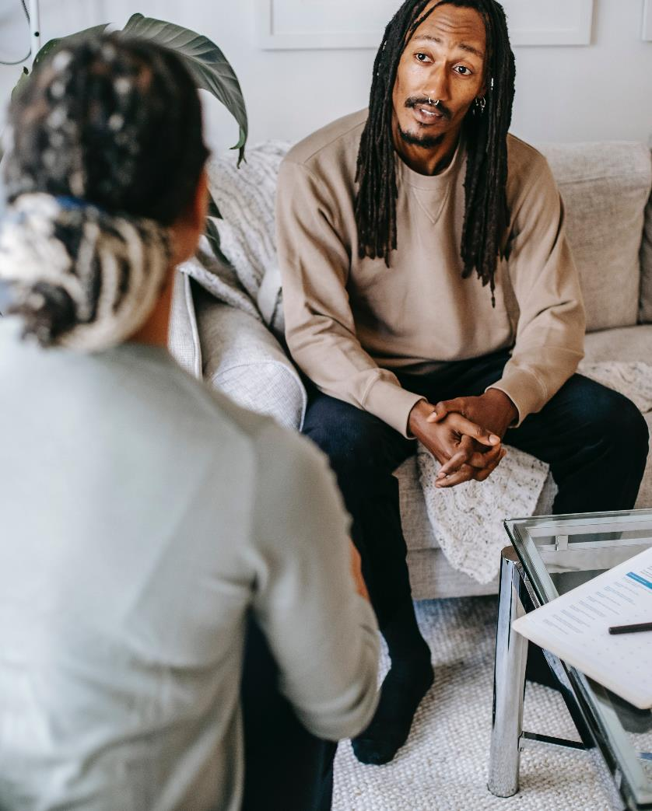
Did you know?
The College of Psychiatrists of Ireland on the Mental Health Service Requirements for Asylum Seekers, Refugees, and Migrants from Conflict Zones tells us
“Refugees, asylum seekers, and migrants have been identified as suffering up to ten times the rate of post-traumatic disorder (PTSD) compared to the indigenous population. For many refugees, asylum seekers and migrants the term post-traumatic stress disorder is not appropriate. This is because the process of migration into an alien culture can mean that the trauma is still ongoing. It has not yet reached the “post” stage”

Slide 7
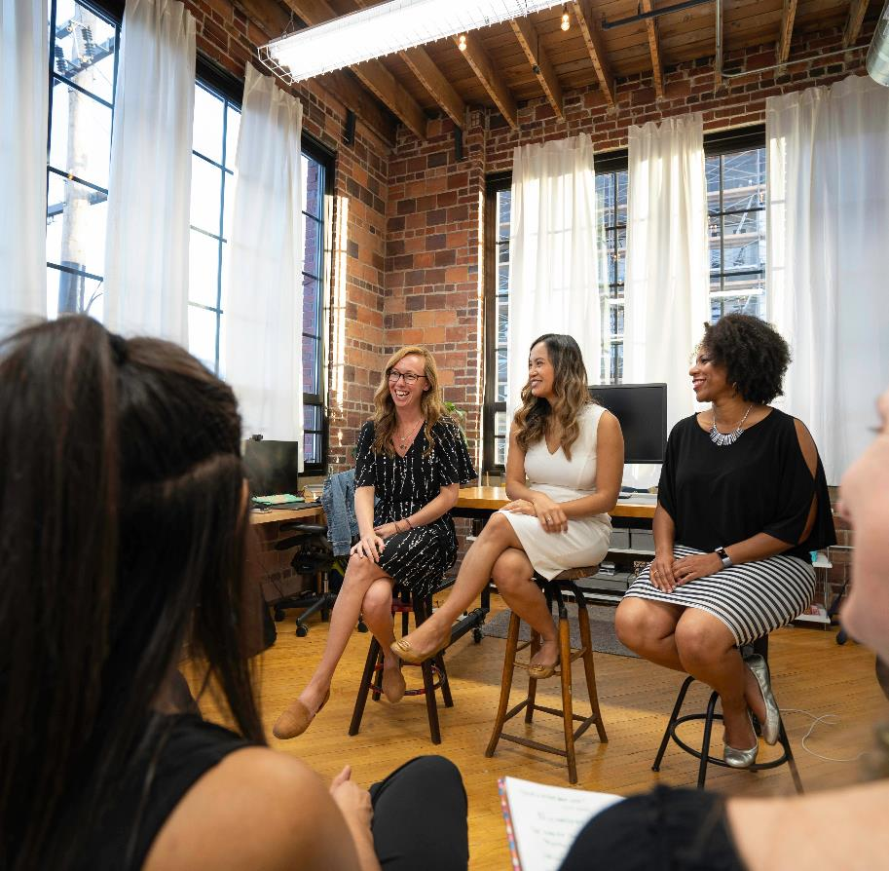
Community
A community is a group of people that interact and support each other, and are bound by shared experiences or characteristics, a sense of belonging, and often by their physical proximity.¹
Cobigo, V., Martin, L., & Mcheimech, R. (2016). Understanding Community. Canadian Journal of Disability Studies, 5(4), 181–203.

Slide 8
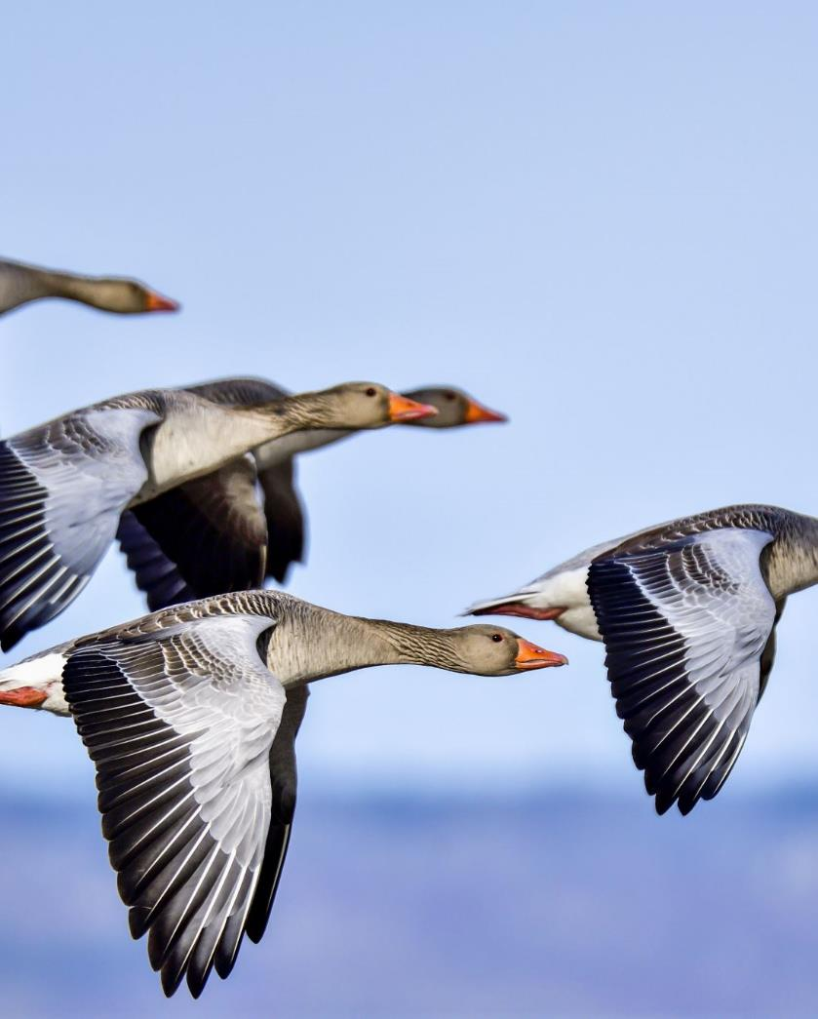
Migration
Movement of a person or a group of persons, either across an international border (international migration) or within a state (internal migration), encompassing any kind of movement of people, whatever its length, composition and causes’. (IOM)
This broad definition covers all forms of migration (voluntary/forced migration, internal/international migration, long-term/short-term migration), different motives for migration and irrespective of the means used to migrate.

Slide 9
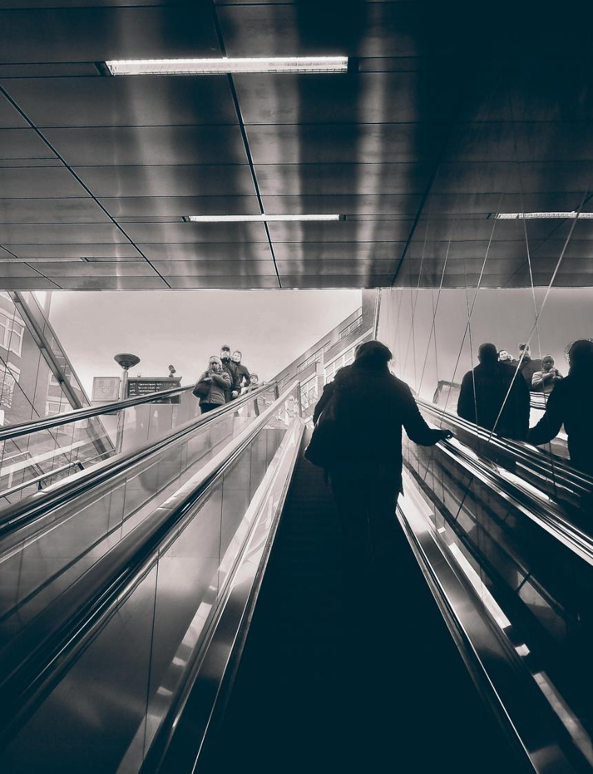
Understanding Migration
The triggers for migration may be personal and/or professional factors including:
a desire to work or study in a different country
a need to move away from dangerous or challenging environments
an economic necessity to find employment

Slide 10
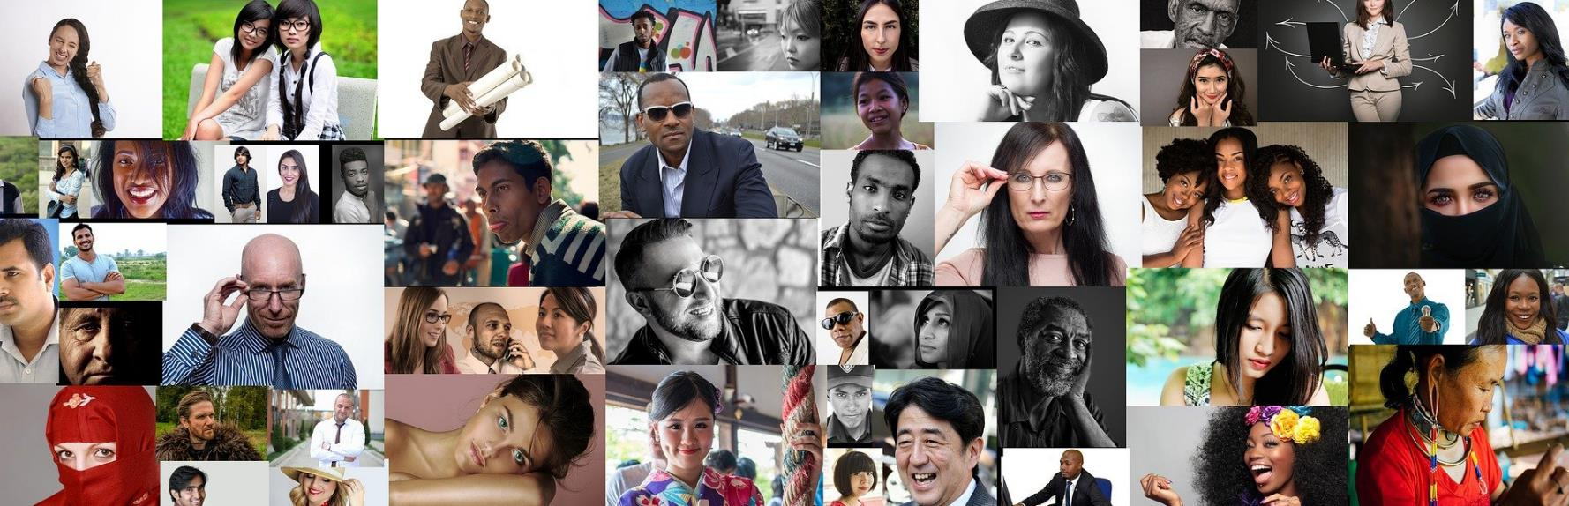
Cultural diversity is where a society or group is made up of many different people. These people are from different countries, races and religions, and have different interests, skills and beliefs. ¹
Cultural diversity
¹ Twose, Rebecca. 2021. The Importance of Cultural Diversity.

Slide 11
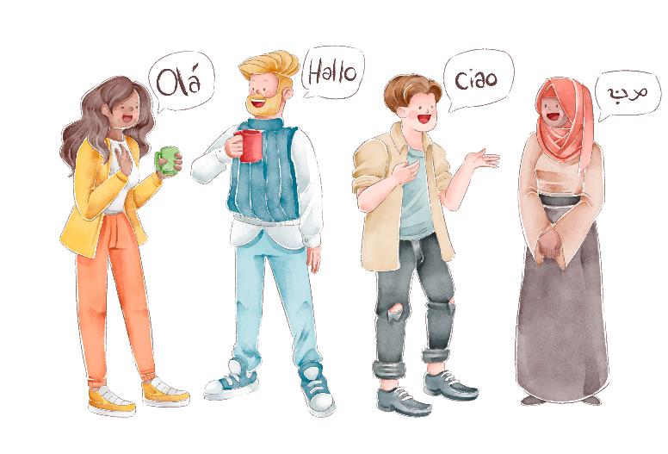
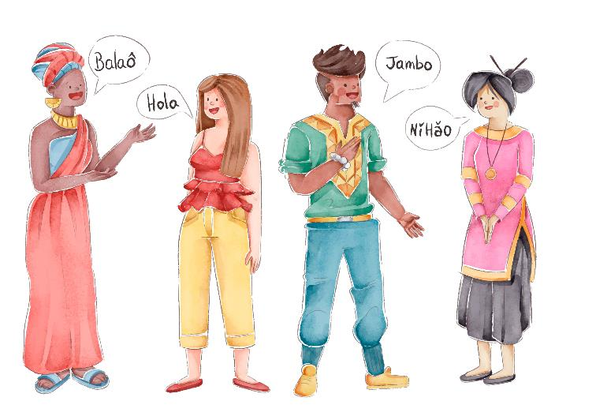
Some key definitions that are important to understand
MULTICULTURALISM is a system of beliefs and behaviours that recognises and respects the presence of all diverse groups in an organization or society, acknowledges and values their socio-cultural differences, and encourages and enables their continued contribution within an inclusive cultural context that empowers all within the organization or society.

Slide 12
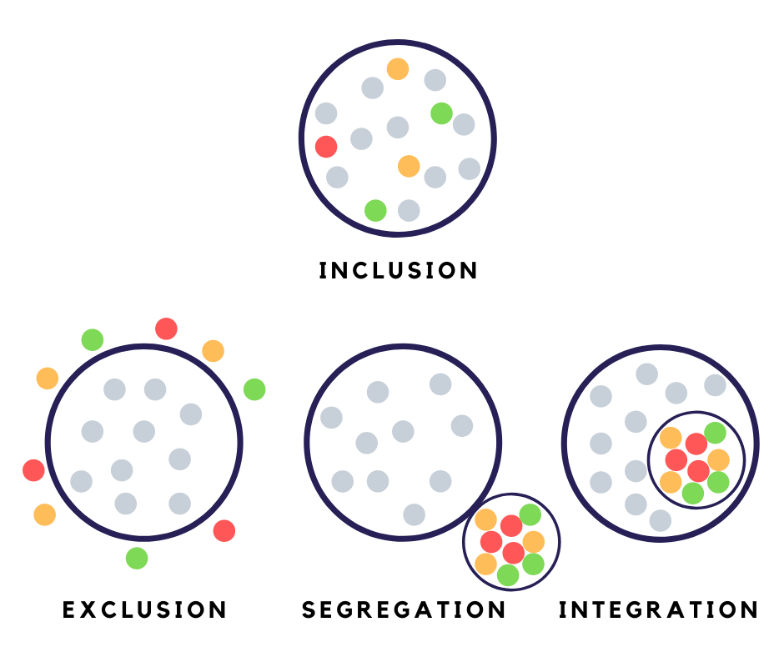
Some key definitions that are important to understand
INCLUSION - According to the UN Department of Economic and Social Affairs, social inclusion is the process by which efforts are made to ensure equal opportunities – that everyone, regardless of their background, can achieve their full potential in life. Such efforts include policies and actions that promote equal access to (public) services as well as enable citizens’ participation in the decision-making processes that affect their lives.
INTEGRATION - According to the Council of European Union (2004), integration is a dynamic, long-term, and continuous two-way process of mutual accommodation, not a static outcome. It demands the participation not only of immigrants and their descendants but of every resident.

Slide 13
What is mediation?
What is community mediation?
Community mediation offers constructive processes for resolving differences and conflicts between individuals, groups and organizations within communities.
Participants’ control the process and create their own alternatives to avoidance, destructive confrontation, prolonged litigation or violence.
Mediation is a “voluntary, structured process whereby a mediator facilitates communication between the parties to a conflict, enabling them to take responsibility for finding a solution to their conflict.”
The goals of community mediation are to support community members in resolving current conflicts, build conflict resolution competency among participants and, ultimately, contribute to more peaceful communities.

Slide 14
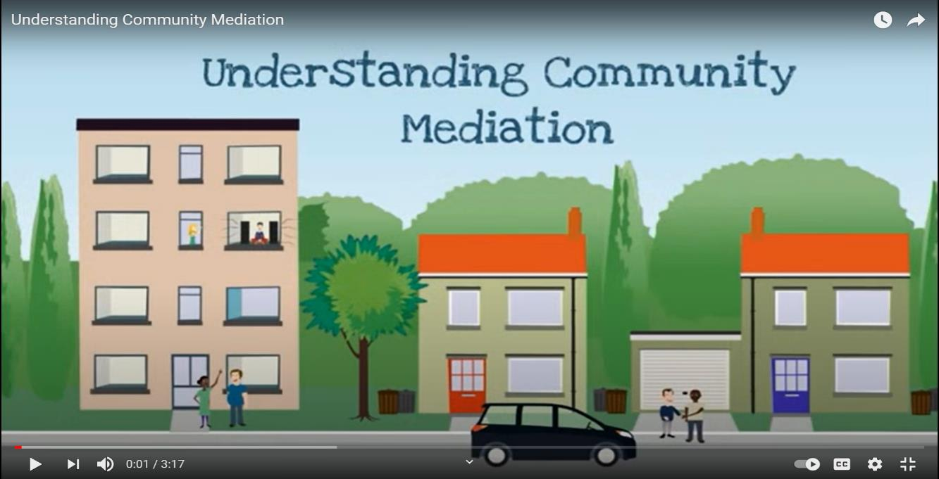

Understanding Community Mediation
Click to watch
https://www.youtube.com/watch?v=YaYxAyV6HZA

Slide 15
Who is a mediator?
The mediator is distinguished as a disinterested, non-aligned third person, facilitating communication between the parties that lead to their own consensual joint decision-making.
In, the context of this project, an inclusion Mediator is not someone who is necessarily providing legal mediation, but rather a non-formal process of negotiation, support, consultation of the involved parties, and overall COMMUNICATION.

Slide 16

Who is a mediator?
Watch and learn
Click to view
„I, as a migrant, wanted to give it back to Ireland and my community. In order to do that, we decided to create an international project about integration and bringing the communities together. The main aim of this international youth exchange was to clarify the fact that migrants should not be abused, but understood and supported” instead.”
Kelvin Akpaloo, Irish Youth Leader and one of the authors of this project

Slide 17
What does a mediator do?
1
2
3
4
Promotes the parties' empowerment, enabling them all to see their responsibility
Plays the role of communication facilitator between the parties
Ensures that problem-solving stays confidential
Impartially and neutrally acts towards two or more people, groups to improve their relationship
TRUST
WORTHY
KIND
PRESENT
FAIR

Slide 18

≠
Intercultural mediation
Formal mediation
The legal process which involves legislation, often courts and official decisions, often a judge. Real civil disputes, real formal roles. Designed more for precise conflict resolution, than for inclusion
Linked with a resolution of conflicts arising amid intercultural inclusion processes, as well as specific policies on integration/inclusion of people with diverse cultural backgrounds, associated with European/national integration or inclusion policies

Slide 19



How can intercultural mediation contribute to social inclusion?
CITIZENSHIP
BELONGING
CONNECTION
ROLE MODELS
NEW HABITS
Improve the exercise of political and social citizenship of newcomers
Improve access (formal or informal) to support networks that promote a sense of belonging
Connect/Bridge different cultures
Promote positive role models
Promote new habits/behaviours

Slide 20



How can intercultural mediation contribute to social inclusion?
JOB SUPPORT
REDUCE RISKS
EMPOWERMENT
SYSTEM DIVERSITY
Help support job-seeking process
Reduce the risk of conflict, verbal or physical attacks on the newcomers through information and emotional connection with them
Improve empowerment of newcomers and encourage their participation in raising awareness activities on migration, forced movement, diversity, social inclusion
Contributes to the introduction of diversity in the “system”

Slide 21
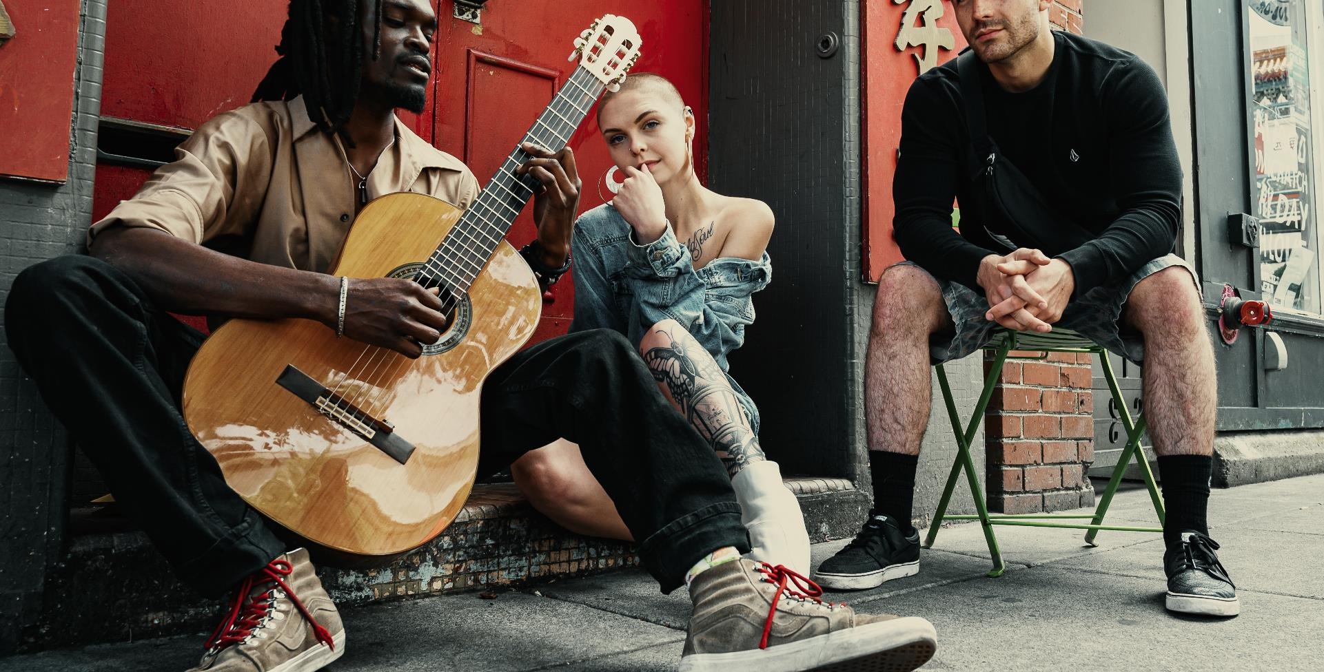
2
Barriers to mediation and overcoming them

Slide 22
Barriers
Barriers to mediation are the contextual elements that prevent a negotiation or dialogue from taking place or succeeding. To understand the barriers that occur, one must understand the context and the setting, the community.

Slide 23
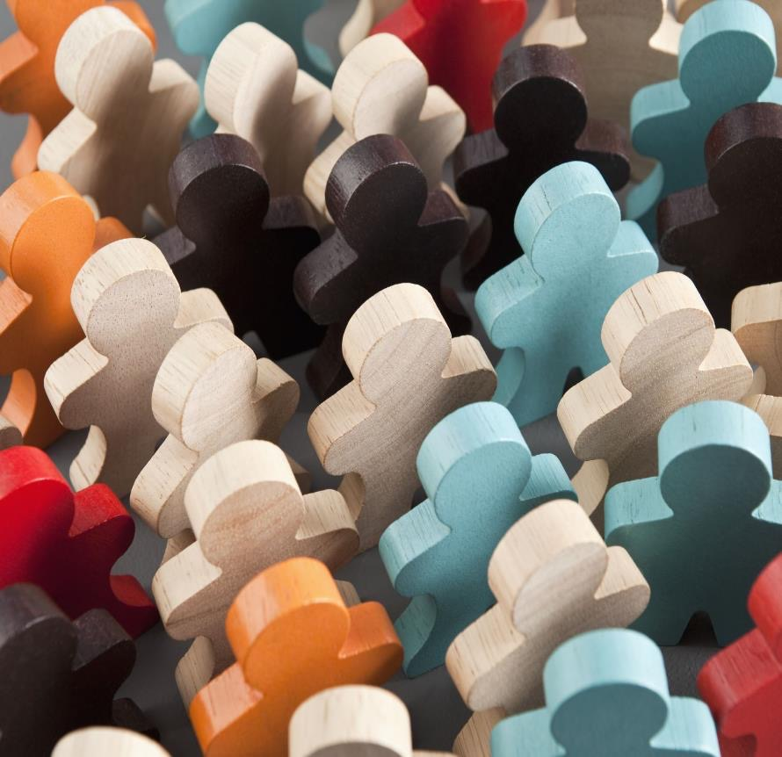
Understanding Community
Community is a unified body of individuals, such as:
the people with common interests living in a particular area broadly
a group of people with a common characteristic or interest living together within a larger society

Slide 24
Most Common Barriers and Challenges that Refugees and Migrants Face
Language
Family
If the native language of the migrant is different from the language of the host country, communication, both oral and written are difficult
Sometimes even with the same language there are cultural differences and different meanings
This influences every aspect of life
For some, keeping the family together is a challenge
For some raising children in a new, unfamiliar culture poses an obstacle
For some, starting a new family is the next natural step that could be delayed by their new situation.

Slide 25
Most Common Barriers and Challenges that Refugees and Migrants Face
Community
Settlement
Getting the sense of belonging is very important for normal social life and happiness
Being accepted into community, acquiring friends, becoming an equal member of the society is not easy, especially if there is a combination of other barriers
Housing, employment and settlement are all more difficult tasks for refugees and migrants
Can be influenced further by a mix of circumstances, for example, legal obstacles to work and to housing, differences in qualification, lack of connections and networking

Slide 26
EXAMPLE - Imagine
A family of migrants comes to a new community
There is a Migrant Community Mediator to welcome them
He/she works closely with the local community centre to organise their orientation day
The Mediator organises the orientation, allowing the family to meet representatives of their neighbourhood, school, community centre
The family experiences no resistance from the host community
The community seems to lack a negative perception regarding migrants
Everyone celebrates by singing: „Imagine all the people Livin' life in peace” by John Lennon ☺
This must be due to the Mediator’s work in FIGHTING THE NEGATIVE NARRATIVE AGAINST MIGRANTS

Slide 27
Knowing barriers before the mediation takes place makes it possible to:
Barriers to mediation are the contextual elements that prevent a negotiation or dialogue from taking place or succeeding
Better prepare oneself and the other parties to negotiate (maturity)
Adapt one’s mediation strategy before and during the discussion
Anticipate factors that could weaken the agreement once it is reached

Slide 28
When negotiation does not seem tactically or strategically the best option from the parties’ point of view
Tactical or strategic barriers
Dialogue = give up: This is when willingness to dialogue, gives the image of a “soft” negotiator. Power asymmetry: The more powerful think they’re going to win otherwise, the weaker ones think they’re not
No potential Area of Agreement: When parties feel strongly there is no room for the agreement, they will hardly engage in any mediation process
No “partner” is in a position (ability or willingness) to base an agreement or to implement it.

Slide 29
They echo the “context in which the conflict and the negotiation take place” and mainly concern the institutions in charge of conducting the negotiation
Structural or institutional barriers
The support base is divided: opposition within your group may be expressed if you appear to be conciliatory.
Political/physical channels are closed: no possibility to enter into a negotiation
The parties see the “other” as a uniform block (the town hall, community Y), rather than as a multitude of actors (people) and potential partners.

Slide 30
Psychological barriers are related to perceptions or emotions and demonstrate that negotiation is an “interactive social process”
Psychological barriers
Non-recognition of the other; discussions confer legitimacy
The fact that reaching an agreement is not always the most important thing:” it is my right”, a matter of justice, which is not negotiable.
Polarisation: in long conflicts, stereotypes can take over, with each side seeing the other as unrecoverable.
The dynamics of reciprocal escalation: with a hit, a hit returned, relative gains become paramount (I must earn more than you, whatever I win).

Slide 31
PSYCHOLOGICAL BARRIERS LINKED TO PERCEPTIONS OR EMOTIONS
Let’s dig deeper into some of the most influential barriers
Psychological barriers are beliefs that a person has about himself/herself regarding his ability, potential, and self-worth. They can be called unhealthy or maybe incorrect thought patterns.
Social barriers are barriers to entry that are created by the culture of the community, i.e., people's behaviour towards newcomers or others in general.

Slide 32
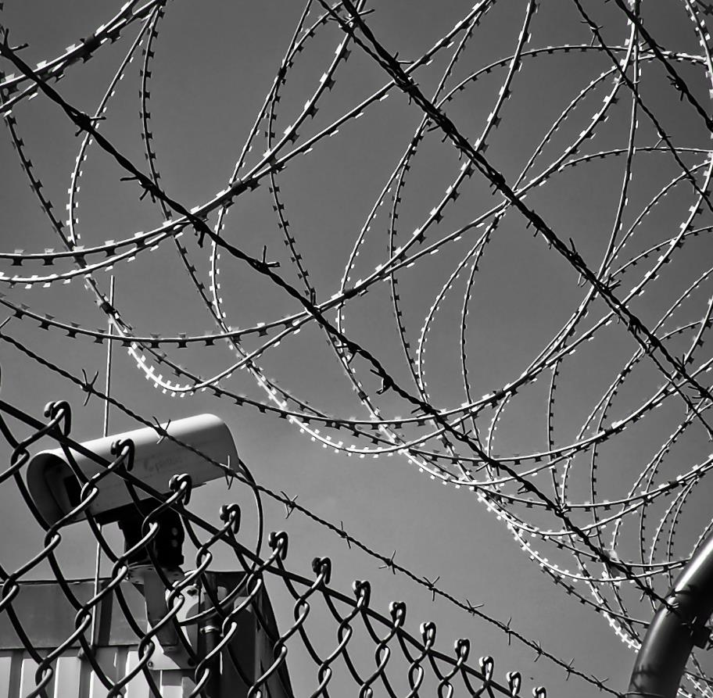
Socio-psychological
Barriers
“The past is never where you think you left it.” Katherine Anne Porter

Slide 33


The Reasons Behind the Socio-psychological Barriers
Intractable conflicts have an imprinting effect on individual and collective life in affected societies
Society members living under harsh conditions of inter-societal conflict experience severe ongoing negative psychological effects
In addition, these narratives rest on a foundation of shared emotions that adds still another powerful vector to the functioning of the barriers¹
¹The nature of socio-psychological barriers to peaceful conflict resolution and ways to overcome them, Daniel Bar-Tal & Eran Halperin, conflict & communication online, Vol. 12, No. 2, 2013

Slide 34
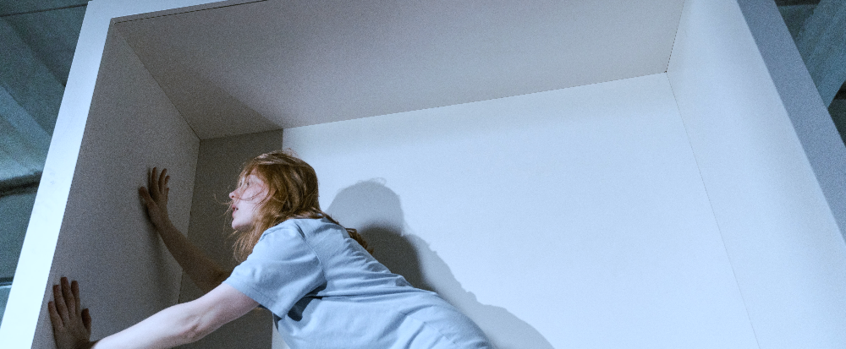
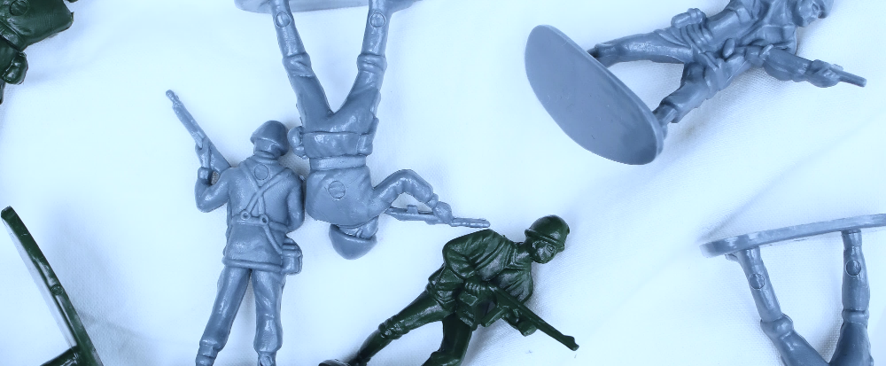
Manifestation of the Psychological Barrier – have you heard of FREEZING?
The state of FREEZING is reflected in continuing reliance on widely held societal beliefs that support the conflict, reluctance to search for alternative information, and resistance to well-founded arguments that challenge these positions.
(Kruglanski, 2004;Kruglanski & Webster, 1996; Kunda, 1990).
Freezing contributes to barriers and is a form of barrier, experienced by the person with life experiences full of conflicts, such as war.

Slide 35
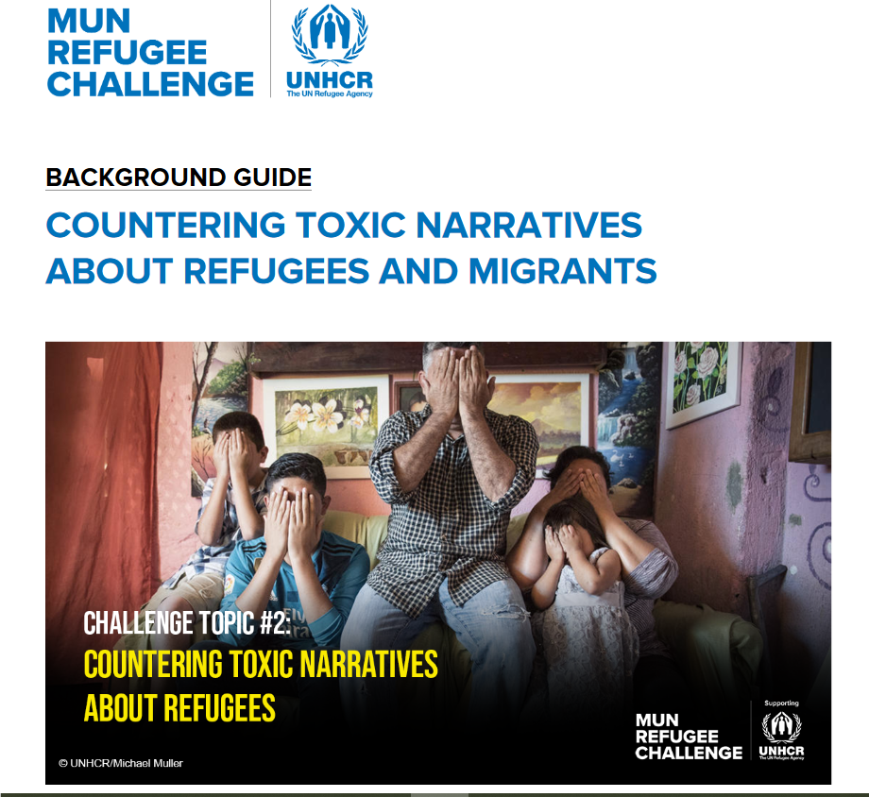

FREEZING: Examples
Someone might have deep beliefs rooted in ideology and experience (war for example) that certain people, cultures, and nationalities are not the ones they want to engage with, and that conflict resolution is impossible.
Persons from host communities might be subject to certain beliefs about new coming cultures. If they formed these beliefs based on any exposure to negative narratives from media or their surroundings, especially if they were subject to those kinds of narratives and influences for a long time.
CLICK ON THE IMAGE TO READ

Slide 36
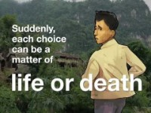

Understand the context
Play the video
“My Life as a Refugee” is a decision-making game that entertains and educates players, compelling them to wrestle with dilemmas faced by millions of refugees. The app features three stories whose characters are separated from their families while fleeing persecution or armed conflict.
Play “My Life as a Refugee”

Slide 37
Unfreezing: Creating the Motivation
Overcoming the psychological barriers that prevent a change
1
2
3
Re-evaluating the held beliefs and attitudes
Searching for new information and ideas
Accept the new alternatives

Slide 38
!
Barriers to intercultural mediation occur due to complex reasons.
The source of barriers can be in individuals, society, host communities, new communities and all together.
The most important step in overcoming barriers is mastering the skill of understanding the people and their circumstances.
Empathy is the most important skill for any peer-to-peer mediator!

Slide 39
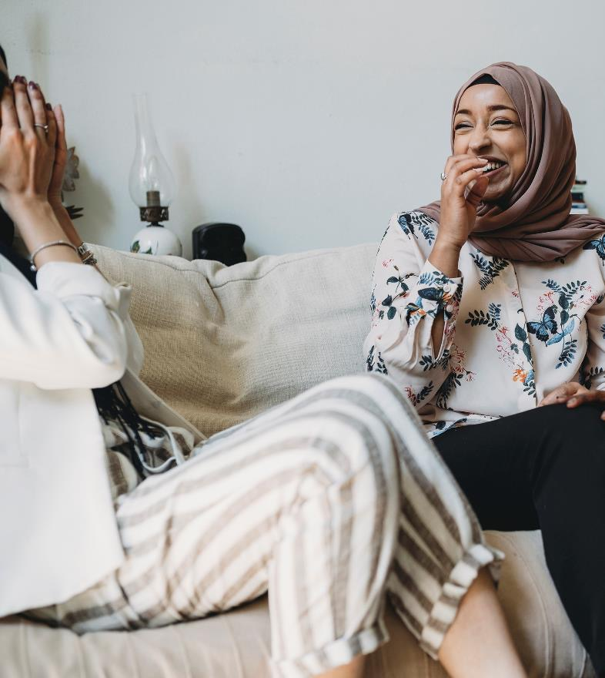
Understanding empathy
Empathy is the ability to understand and share another person’s feelings and emotions. It is essential to building good relationships.
The research shows that empathy is partly innate and partly learned.

Slide 40
Walk in other’s shoes: Empathy
Get out of your usual environment
Examine your biases
Cultivate your sense of curiosity
Challenge yourself
Get feedback
Undertake challenging experiences which push you outside your comfort zone, this teaches humility
Travel, especially to new places and cultures. It gives you a better appreciation for others.
Ask for feedback about your relationship skills from family, and friends. Check-in with them periodically to see how you’re doing.
Don’t think you have any biases? Think again - we all do
Curious people ask lots of questions, leading them to develop a stronger understanding of the people around them

Slide 41

Some tangible examples of mediation
As a social/intercultural Mediator, the previously mentioned barriers are the fields in which your help would be very often needed
To help you can provide translation and accompany your peer migrants at the meetings, support them with phone calls, teach them the language
Find out about reliable childcare services, family supports
Help them make friends, introduce them to the members of your community
Point them towards up-to-date information and institutions about housing, job search and other areas they might need
Do you think you could face some of the before-mentioned barriers while performing these examples of mediation?

Slide 42
5 Further Challenges while doing Mediation Work
Resources
Access to Information
Mutual Trust
Setting Personal Limits
“Migrant as victim” narrative

Slide 43
Overcome and BECOME!
The future Modules will train you and prepare you to overcome barriers and become the Intercultural Community Mediator, but here are some early hints:
Resources: plan well, make an action plan, prioritise well to best distribute available resources, find support, negotiate
Access to information: Research, network, volunteer, communicate, ask
Mutual trust: be impartial, do not let emotions overtake, plan, deliver, communicate, respect
Personal limits setting: Respect your time, it’s ok to say no, it’s ok to say I don’t know
Negative narrative about migrants is best challenged by the positive stories, start with your own positive example and be active

Slide 44
3
Role models in mediation for inclusion

Slide 45
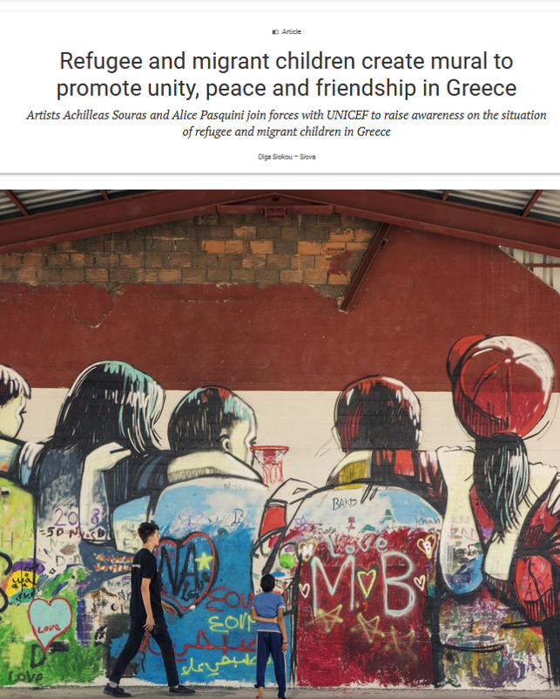

Click and read
„Mediation is another word for FRIENDSHIP.
Community Mediators provide friendship through many different forms.”
- INCLUDE ME project team
https://www.unicef.org/eca/stories/refugee-and-migrant-children-create-mural-promote-unity-peace-and-friendship-greece

Slide 46
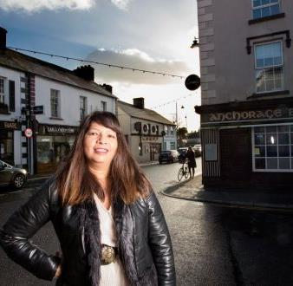

Meet Lola Gonzales Farrell
„I feel people are more welcoming in this community now. I think we’ve made a difference in how people see migrants. I’ve just had the tidy towns contact me to ask if people in my group can get involved. There’s also a lot of reaching out to include asylum seekers.„
CTRL + Click on the image to read the article
https://www.irishtimes.com/life-and-style/people/racism-is-a-problem-in-ireland-but-it-s-minimal-in-carrick-on-shannon-1.4756995

Slide 47
Meet Lola Gonzales Farrell: Inclusion and integration mediator
She moved to Co Leitrim, Ireland in March 2015
She works in a charity shop in Carrick-on-Shannon, Ireland and is now its manager, doing really interesting work in sustainable fashion and other causes
She manages a group of volunteers rather than paid staff
Selected by the Immigrant Council of Ireland to participate in their Migrant Councillor Internship Scheme Migrant-Councillor Internship Scheme | Immigrant Council of Ireland
She was recently shadowing Councillor Sean McGowan as part of the programme with Leitrim County Council

Slide 48
Role models in mediation for inclusion contribute to:
Inspiring others to mingle, participate in social inclusion activities, to share knowledge, experiences
Empowerment of socio-cultural communities and their members, and offer opportunities, for example accessing the job market
Representation of diverse members of the community, important for peacebuilding cohesion and overall wellbeing

Slide 49
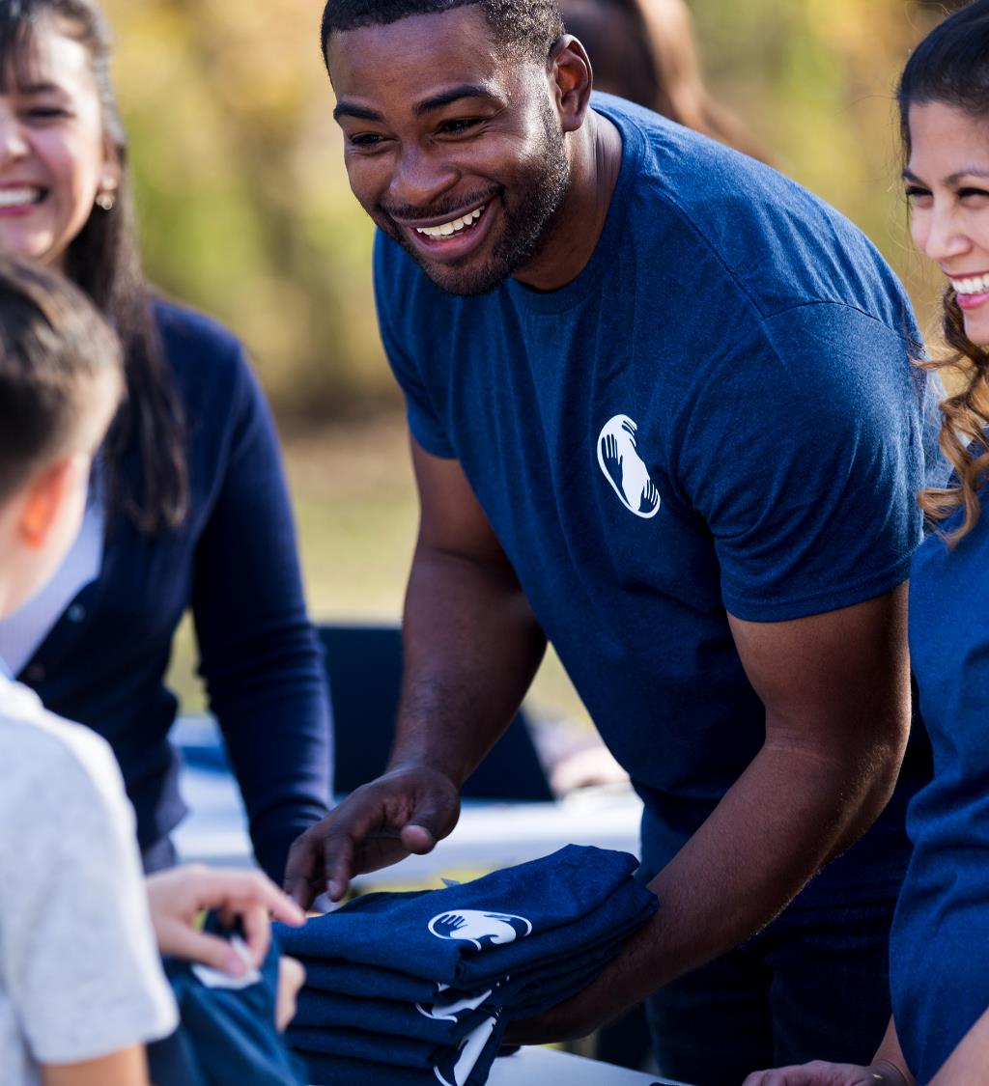
Intercultural mediation
Mediators from different backgrounds assist in breaking down barriers around inclusion – by their actions, they are showing positive leadership and being positive role models, which paves the way for others in new communities.
Intercultural mediation actively impacts on different fields, among them: the economic (potential access to the job market), political (promoting access to public services and offering information about rights and responsibilities, among other elements) and social (contributing to enlarge the networks and relationships, visualizing newcomers and their contributions to the host societies, promoting positive models and new behaviours).

Slide 50
Want to become a mediator – start as a volunteer?
You need to COMMUNICATE your volunteering aims, look for host organisations and get in touch with them
Each organisation has its own rules that every volunteer must follow. You need to agree on what your COMMITMENT is, and do your best to stick to that
FOCUS: Volunteering can be a great experience for sharing cultures, and tradition, learning the language, developing new skills, and meeting people from all over the world

Slide 51
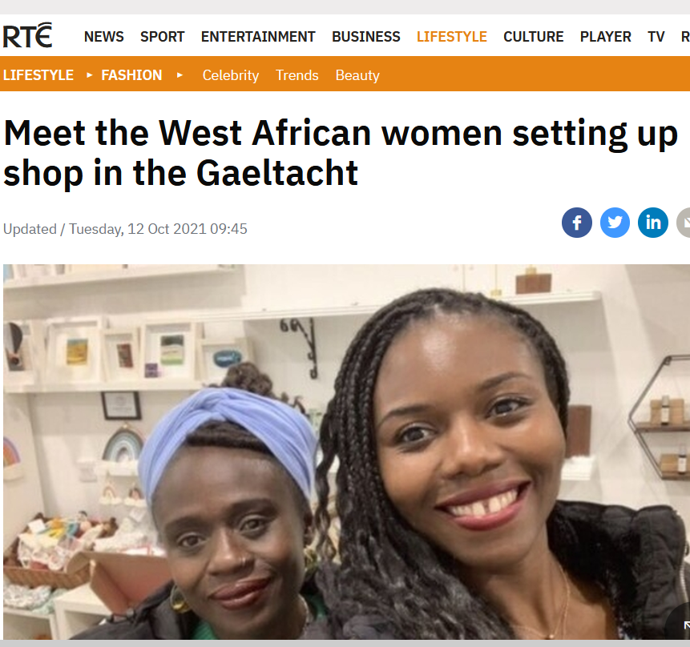

Role models matter, read the full article here – CTRL + click on the image
https://www.rte.ie/lifestyle/fashion/2021/1011/1253040-meet-the-west-african-women-setting-up-shop-in-the-gaeltacht/?fbclid=IwAR0VqptHJM_WfIwQ3dAePVBBFGLr44KNZxaqDdwhqvAOO7FZMsJQcWaqh6E
"I hope that Ro and I, as two black women from West Africa now in a shop in the West of Ireland, will inspire other people - especially non-Irish women - to go for it and not to be afraid. We're always here to give support."

Slide 52
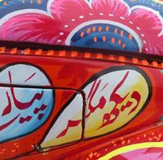

Role models matter
Read the full article here – click on the image
𝗦𝗢𝗕𝗜𝗔 𝗦𝗔𝗔𝗗 - 𝗣𝗔𝗞𝗜𝗦𝗧𝗔𝗡 𝗠𝗘𝗘𝗧𝗦 𝗜𝗥𝗘𝗟𝗔𝗡𝗗 𝗔𝗥𝗧 𝗜𝗡𝗦𝗧𝗔𝗟𝗟𝗔𝗧𝗜𝗢𝗡
On Kilkenny Day Sobia's beautiful art installation on Canal Square. This piece is decorated to represent the pride Pakistani truck drivers take in their vehicles using Sobia’s first Irish car as a canvas. Sobia has a Masters degree in printmaking and fine arts and has been based in Ireland for 4 years.
Source: KilkennyDay Facebook page
https://www.facebook.com/KilkennyDay/posts/352650033262974
CTRL + click and read

Slide 53
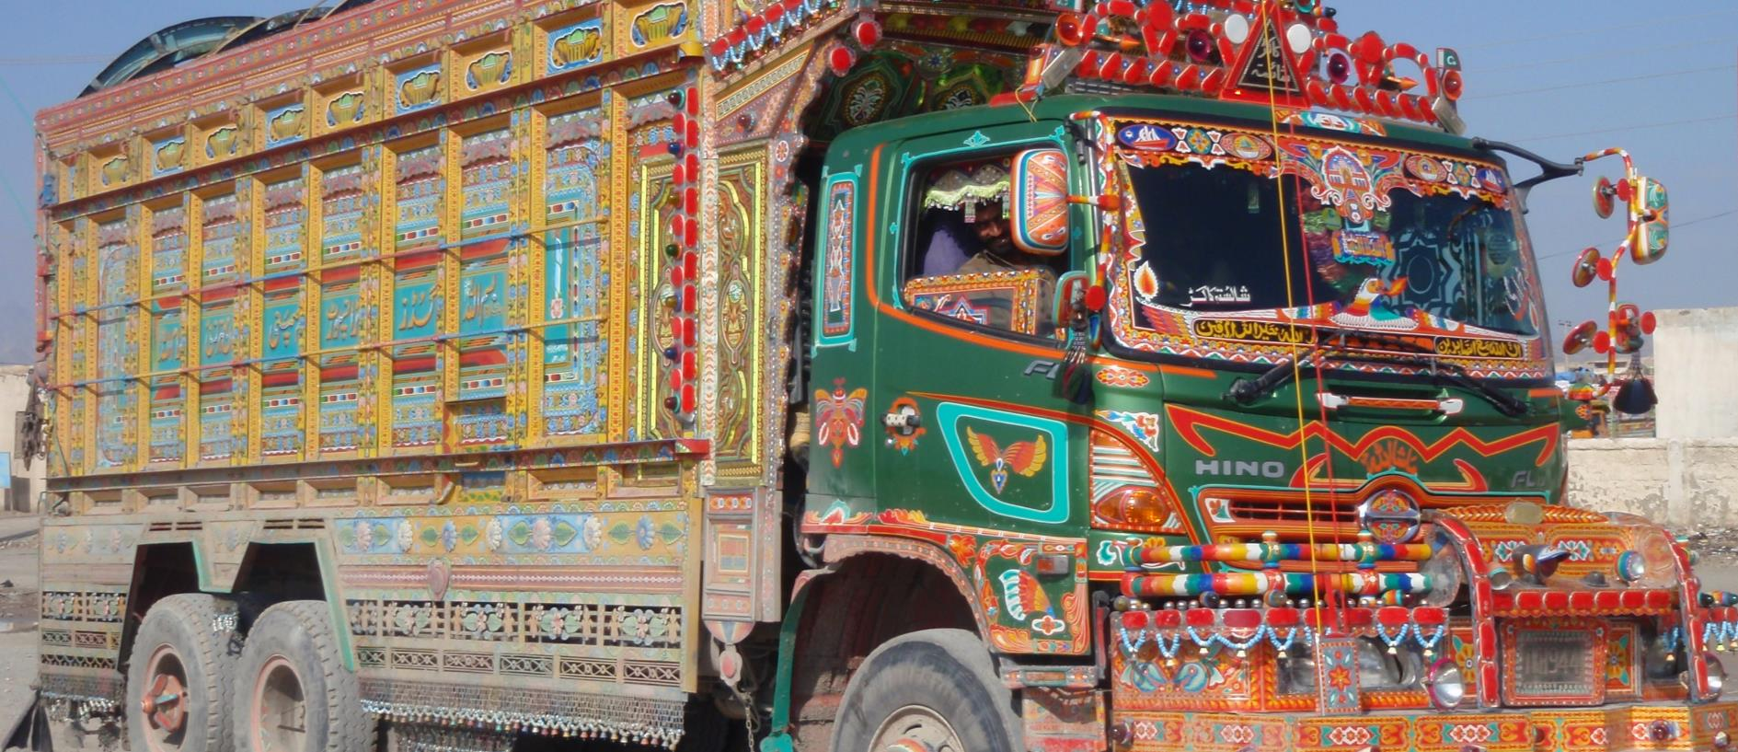
'Truck Art'- The pride of Pakistan
Understand why Sobia’s art was an important mediation tool: read about truck art in Pakistan: https://en.dailypakistan.com.pk/03-May-2018/truck-art-the-pride-of-pakistan

Slide 54

EXERCISE
Let’s analyse
As a role model through the arts, Sobia produced some positive effects. Can you think of:
Who benefits from enjoying Pakistani art in the Irish community of Kilkenny?
How do you imagine Pakistani communities in Ireland feel when seeing this example?
Can you name the reasons why this action has enriched the lives of Kilkenny community?
Why is this mediation too?

Slide 55

4
How to start peer-to-peer mediation as a migrant

Slide 56
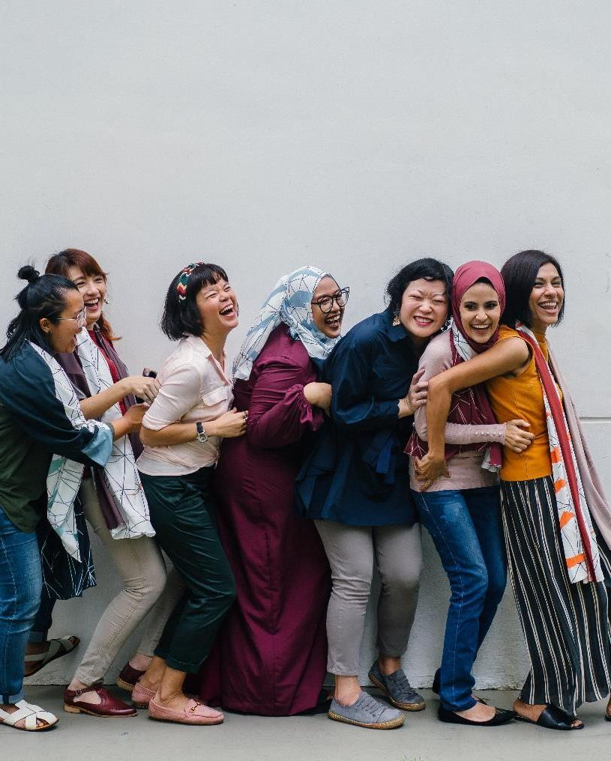
“The mediator between head and hands must be the heart!”
- Thea von Harbou, Metropolis

Slide 57
Becoming a mediator
The definition of requirements for mediators differs from country to country.
Different studies highlight “the importance of intercultural mediators—individuals who serve as 'bridges' in communication and possible conflict resolution between immigrants and the host society—in promoting the integration of immigrants.
In some countries, the intercultural mediator often appears as a mere linguistic translator/interpreter that mediates/interprets and delivers a message between the administration services, its officers (health, work, social service workers, educators, lawyers) and the users.
Mediation, however, is not just translation!

Slide 58
Required skills for peer mediation
They promote a change in attitude toward conflicts, as those involved improve their perspective, develop leadership skills, learn to tolerate alternative points of view, and realize that they can respond in a more constructive way to frustrating circumstances
Be a good listener
Be friendly
Be a good facilitator/moderator
The benefits of a peer mediation are wide
Adapted from source: https://www.irex.org/sites/default/files/node/resource/conflict-resolution-and-peer-mediation-toolkit.pdf

Slide 59
Peer mediation can provide a positive climate
Have good emotional intelligence and empathy
Have good communication skills
Understand the importance of clarifying and questioning
The strategies and skills learned become a process that defines values and lead to growth (Rogers, 1994)
It is a way to learn about conflict resolution and problem-solving skills

Slide 60
You are adopting lifechanging skills
Be good at identifying problems
Understand the parties
Be objective, impartial & fair
And becoming a better person

Slide 61
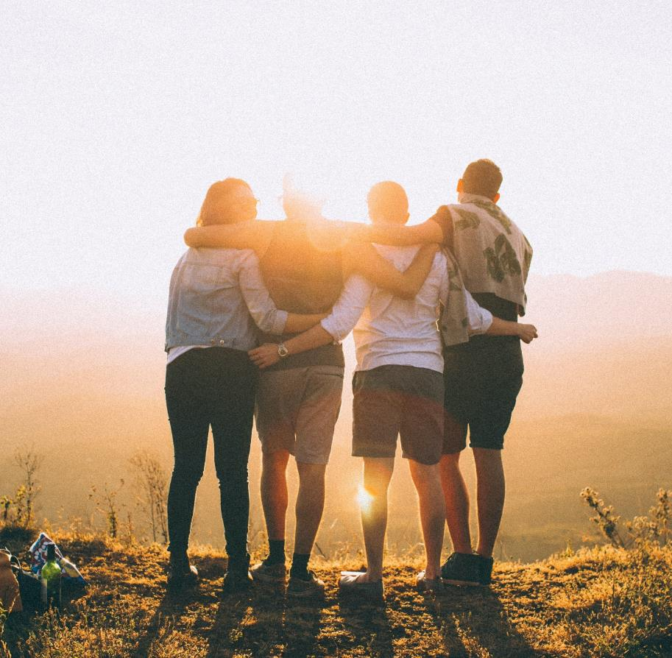
Why is mediation important?
Change in attitude toward conflicts
Improved perspective for those involved
Development of leadership skills
Tolerance of alternative points of view
Development of constructive responses to frustrating circumstances
Improvement of problem-solving skills
Adapted from source: https://k12engagement.unl.edu/strategy-briefs/Peer%20Mediation_0.pdf

Slide 62
Why is mediation also important?
3
5
Saves time and money
4
Avoids legal action
Affordable
1
Confidential process
Fair and
impartial
2
Adapted from source: https://www.mediatethurston.org/10reasons.html

Slide 63
Why is mediation also important?
8
Identifies underlying issues
10
9
Empowers people
Fosters
cooperation
6
Allows personalised solutions
Improves communication
7
Adapted from source: https://www.mediatethurston.org/10reasons.html

Slide 64

Specific fields of intervention
We can take a look at the most common situations and fields that migrant community mediators/intercultural mediators operate in.
Specialisation is possible, however, if you are known as a go-to person for mediation, it is expected that you will be supporting your peers in more than one field.

Slide 65
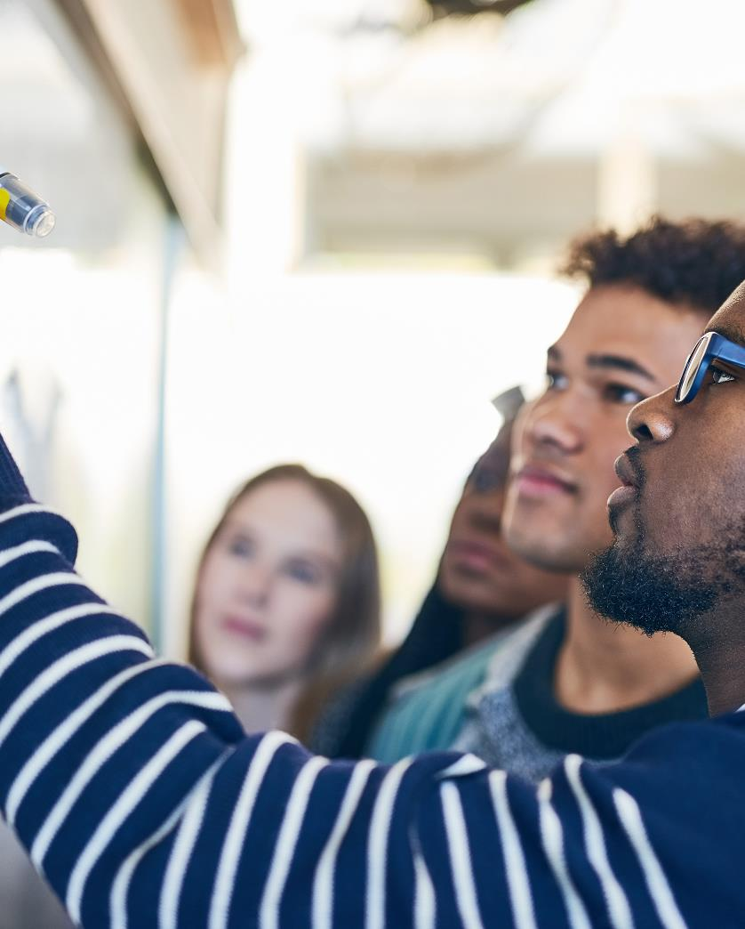
Education
Supporting your fellow students in their inclusion processes is one of the noblest missions of being a mediator.
Are they new to the system, to the community, do they have opportunities to implement their previous accreditation and knowledge better if only they stepped forward?

Slide 66

Health
A major field of intervention is in healthcare.
The migrant patient–healthcare provider relationship, often needs support from someone who has been through the process.

Slide 67
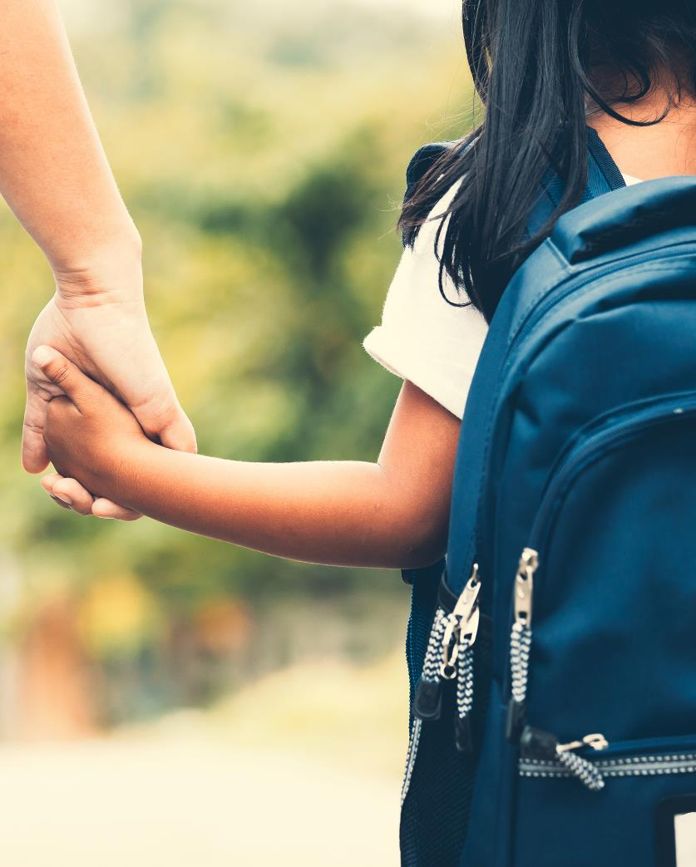
Childcare
For any peer that has childcare to think of, this is one of the priorities.
Childcare provides inclusion opportunities for children and families are usually in the rush to get this sorted.
It is almost impossible to commit to studies, employment and inclusion activities if the childcare is not in place.
Do you know how childcare works in your region? Where to start?

Slide 68

Housing
Starting life in a new country is a huge challenge for everyone involved. The housing needs and choices of immigrants and refugees are mostly dependent on their registration status, affordability and access to social or individual procedures that can lead to finding proper accommodation.
If you know which institutions to go to and which steps to make, you can effectively assist migrants in accommodation issues and sensitize the local community to
develop acceptance.

Slide 69

Public services and labour
Public services and their tasks towards immigrants, as well as the welfare
provisions available for migrants in the host country can be confusing and daunting for migrants.
In addition, issues of labour legislation,
immigrant employment policies and procedures for hiring immigrants are not always easy to understand and navigate, but you might have the knowledge and the will to share...

Slide 70

EXERCISE
How would you assist them to resolve their conflict?
In your apartment building, an immigrant family who moved in recently made some noise after 10.00 pm (Silent time starts at 10 pm and ends at 7 am in Finland) every day. A Finnish family who lives next door starts shouting at them after 10 o’clock: „You have been living in Finland for 10 years and have been known both families quite a while. Each family comes to you for help.”

Slide 71

EXERCISE
How to start with peer-to-peer mediation
Given this dispute between your neighbours, how would you assist them to resolve their conflict? (Read the case in the previous slide)
Introduce yourself and your role as a mediator,
explain the mediation process and briefly talk about the case,
assist them to find a common ground and have an agreement.
Please write down how you would introduce yourself and your role as a mediator, how you would explain the mediation process and talk about the case, and how you would assist them to find a common ground and have an agreement:
________________________________________________________________________________________________
________________________________________________________________________________________________
________________________________________________________________________________________________

Slide 72
REMEMBER THE STEPS!
Step 1
Step 2
Step 3
Introduce yourself and your role as a mediator.
Explain the mediation process and briefly talk about the case.
Assist them to find the common ground and have an agreement.

Slide 73
Neighbourhood Disputes are one example where mediation is needed more often, as a result of COVID tensions (people are at home, people get bored!)
MEDIATION HELPS TO BRING PARTIES/NEIGHBOURS TOGETHER TO SOLVE THEIR DISPUTES AND MAKE EVERYONE’S LIFE EASIER.
With the help of the mediator, the parties can come together to talk about their disputes and find a common ground to solve them.
The mediator helps both parties to listen to each other’s perspectives and to feel heard. In this way, they find a common ground to solve their disputes.
SOURCE: MTV News

Slide 74
How it can be done
The mediator brings the parties together
The mediator helps the parties to communicate
The parties find the solution to their disputes themselves with the help of the mediator before the situation escalates to a more serious problem
The mediator plays an important role as a neutral listener. They can make people understand that reconciliation is important and that it will ultimately make life easier for everyone

Slide 75
6
What success looks like

Slide 76
Recognise successful mediation
In the next 6 steps, we will show what
GREAT MEDIATION
looks like
SOURCE: Tips for solving disputes by Maija Gellin and Pia Slögs from the Finnish Forum for Mediation.

Slide 77
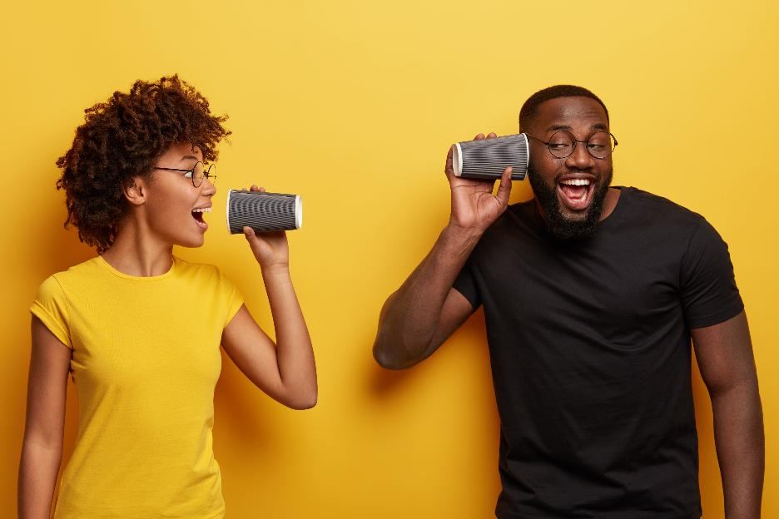
Mediation done well
Notice that everyone's perspective or story is valuable. Calm down and calm down the situation and listen to everyone even if you have a different view.
1
Among the central needs of parties to a dispute are the need to be heard and the need to be understood.
In a restorative discussion, these needs begin to be fulfilled and feelings of hurt subside, which gives room for finding solutions.

Slide 78

Mediation done well
Express how you perceive what has happened without blaming anyone. "In my opinion, what happened was..." is a better way to begin explaining your views than declaring your own truths or blaming others.
2
In mediation, we do not concentrate on who is guilty or on punishments.
The restorative approach to mediation is solution-oriented and its aim is to restore functioning relationships between people.

Slide 79
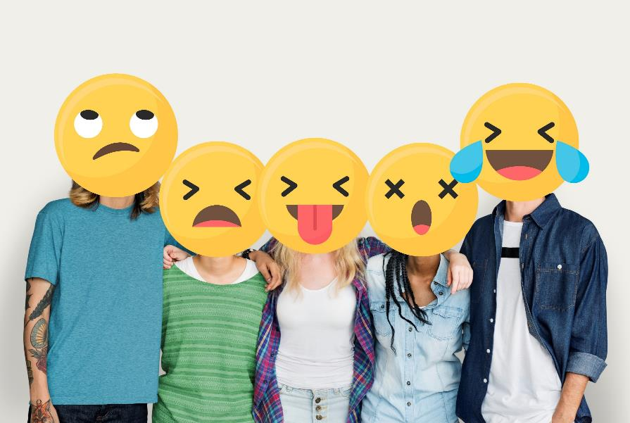
Mediation done well
Ask about the feelings of all parties and talk about your own. Don't force your own assumptions on the feelings and thoughts of others upon them. Interrupt any possible accusations/blaming of others and guide the conversation back to people's thoughts and feelings.
3
It is important for mediation that all parties speak about their feelings.
Expressing and understanding one’s own feelings is an essential part of the mediation process.
Feelings are also used to support redefining situations.

Slide 80
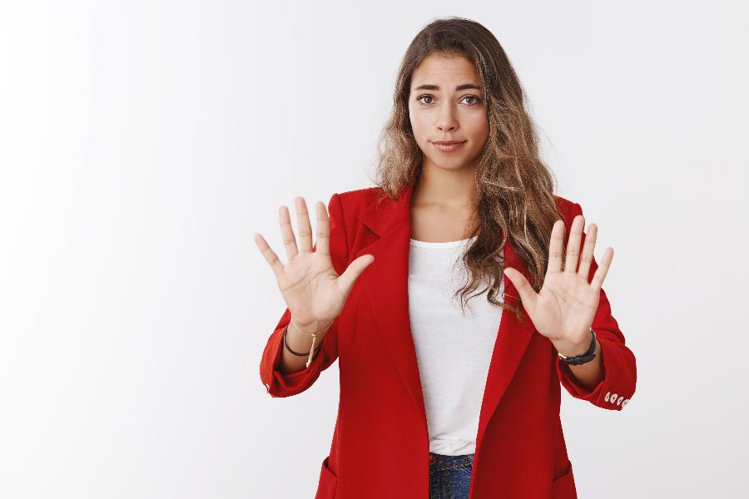
Mediation done well
Provide enough time for the stories and the feelings of the parties in mediation, and only then move on to look for solutions. When everyone feels heard, it enables participants to take true ownership and responsibility of the situation.
4
The value of not being in a hurry: it is important to give time for the stories of those participating in mediation, in order for them to feel like they were genuinely heard. Whether the mediation brings results depends on the fairness of the process, as perceived by the parties. Importantly, the feeling of being heard is closely linked with experienced fairness/justice.

Slide 81
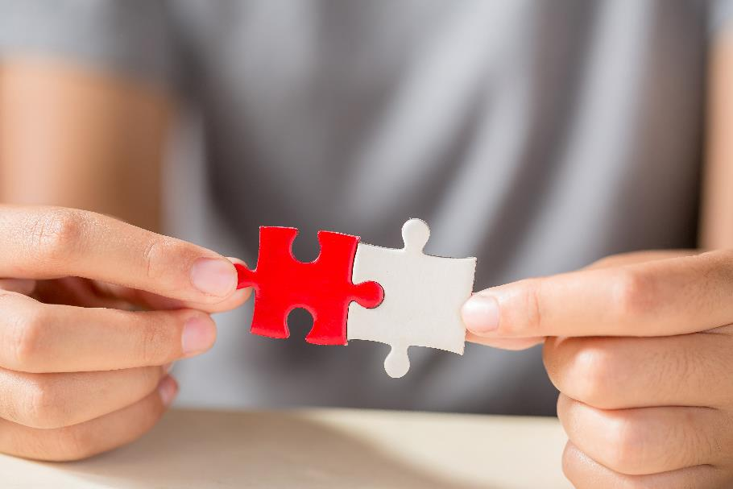
Mediation done well
Solutions are often simple promises that stop the conflict from repeating itself. Give everyone room to look for solutions and make the decision on how to behave in the future together. The parties to the conflict are experts of their own conflict.
5
The restorative approach to mediation is solution-oriented.
It is important that the parties decide on the solutions themselves, for then it is easier for them to commit to the agreement.

Slide 82
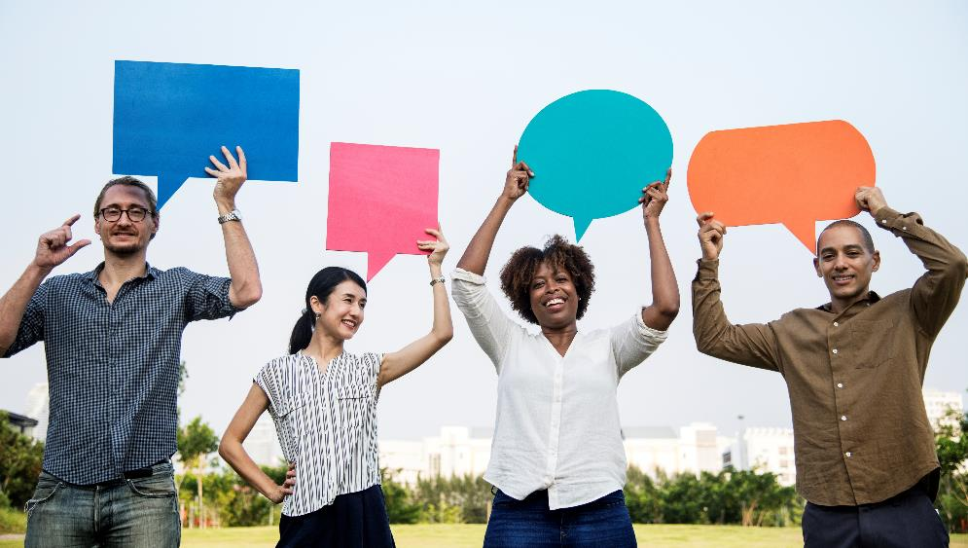
Mediation done well
Take care of the follow-up. Pay attention to any signs of positive change in line with the agreement and give positive feedback about it to others and to yourself. Let successes wipe away the last bits of resentment and hold on to positive development.
6
Follow-up and nurture positive feedback. It is important to observe any positive changes and to give positive feedback about them.
This supports good development and helps to build sustainable peace.

Slide 83
All intercultural mediation is supporting conflict resolution.
Even when we show examples of advocacy or representation, that still means a mediator (advocate, artist...) is working on reducing the conflict of any negative narratives, a conflict that exists in the reduced sense of belonging or reduced inclusion.
REMEMBER: Not all conflicts are loud!
Here are some examples of mediation done well.

Slide 84
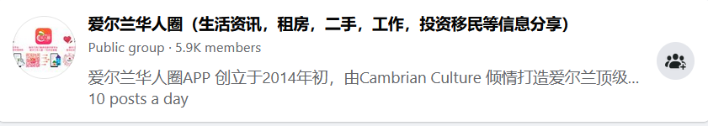
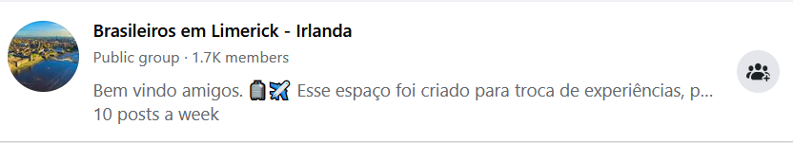
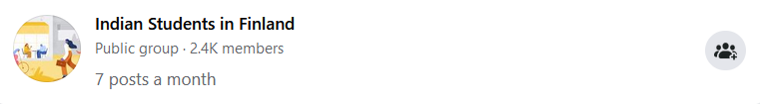
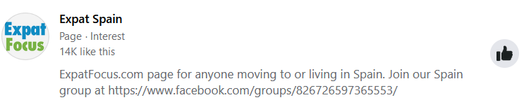
You have probably seen successful intercultural mediation many times online.
Do you know what these are?

Slide 85

Online groups, on social media, such as Facebook and LinkedIn groups often serve as a source of information, support and orientation for migrants, refugees, expatriates in different countries.
They are also important tools to advance peer-to-peer mediation.
These groups host large numbers of members and have huge popularity and volume of information exchanged daily, which shows the success and relevance of the mediation approach.

Slide 86
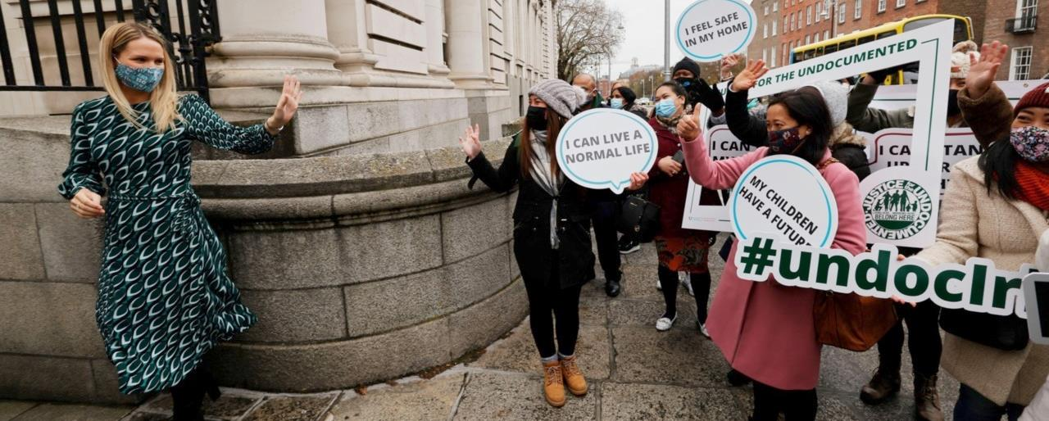
Another mediation success example from Ireland
Undocumented migrants and asylum seekers can now regularise status via 'once-in-a-generation' scheme

Slide 87
As a result of advocacy, the policy makers made positive changes
Direct Provision in Ireland is a means of meeting the basic needs of food and shelter for asylum seekers directly while their claims for refugee status are being processed rather than through full cash payments
However, people often felt stuck within the system and their status has been unresolved for years, leaving them unqualified for work, housing, etc.
Up to 17,000 undocumented people may be eligible, including 3,000 children
Now, as a result of advocacy (mediation) efforts, the regularisation scheme will bring certainty and peace of mind to the thousands of people
Inviting asylum seekers to apply would help address “legacy asylum cases” and ensure the new asylum accommodation system to replace direct provision will be fully operational by 2024

Slide 88
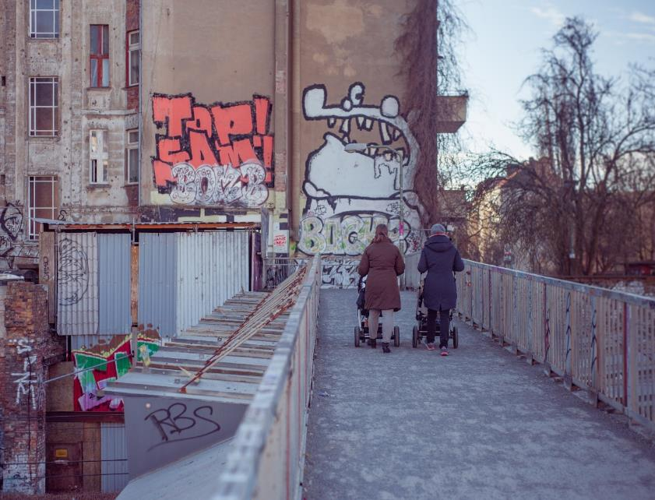
Ireland direct provision
- Let‘s Match Mums
Let‘s Match Mums matches mothers in Direct Provision (DP) centres to mothers outside of DP who would like to donate some clothes, toys, nappies and other baby equipment.
With Let’s Match Mums, the hope is to help promote sustainability as well as catering to the needs of asylum seeker mothers who need our help.
This way mums act as peer-to-peer mediators.
For more information, read the article :
https://www.letshelpdirectprovision.com/initiatives/lets-match-mums

Slide 89

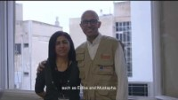
Cultural Mediators
Danish Refugee Council
Click to watch the video
Cultural Mediators from Danish Refugee Council in Greece help refugees/asylum seekers to communicate with the locals, learn their rights and familiarise themselves with the procedures.
SOURCE: Danish Refugee Council

Slide 90
How it was done
The mediators helped refugees/asylum seekers to communicate with the locals with translation and interpretation in their everyday life.
They taught them the procedures so they can do these procedures alone in the future.
They became a bridge between locals and refugees/asylum seekers and filled the cultural gap.
Both locals and refugees/asylum seekers benefited from the cultural mediation services.

Slide 91

Mediation done right has deep impacts on the life of individuals and the cohesion of the community!

Slide 92
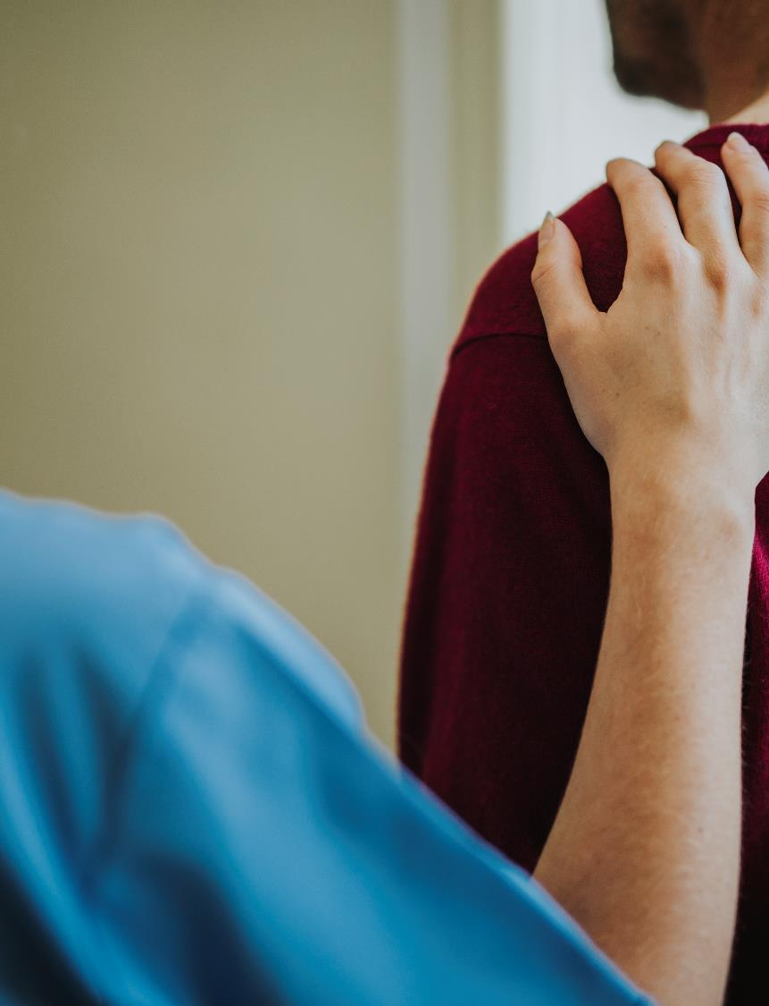

“
At the hospital, they treated me very well and the cultural mediator was with me all the time at the hospital, at the psychologist. Because of DRC cultural mediators, our daily affairs became easier.

Slide 93
Main conclusions to this module
IMPORTANCE
SKILLS
BARRIERS
SUCCESS
Fosterts inclusion
Empathy
All parties can have them
The positive impact is wide
Develops the community
Impartiality
Understand them to overcome them
Builds relationships and leadership, solves problems

Slide 94
Thank you and congratulations on finishing Module 1!
Next up:
Module 2 - Leadership and advocacy skills in developing strong, positive and equitable communities
www.includemeproject.eu

